Slide 1

CN101.3 - Data Communication and Network
Department of Network and Security
WAN Technology
Isuru Sri Bandara
isuru.s@nsbm.ac.lk

Slide 2
Switched Communications Networks Terminologies
Nodes – Switching devices that provide communication
Stations – Devices attached to the network
Communications Network – Collection of nodes

Slide 3
Switching Networks
Switching Networks
Circuit Switching
Packet Switching

Slide 4

Circuit Switching ?

Slide 5
What is Circuit Switching
Method use for establishing a physical dedicated communication path between the sender and the receiver.
Circuit switching is connection-oriented.
Circuit Switching has three phases
Establish
Transfer
Disconnect
Establish ------→ Transfer ------→Disconnect

Slide 6
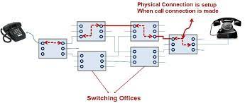
Circuit Switching
Need to have physical path & Dedicated path, in order to establish the connection
Ordinary voice phone service is circuit switched.

Slide 7
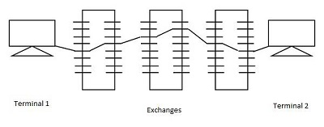
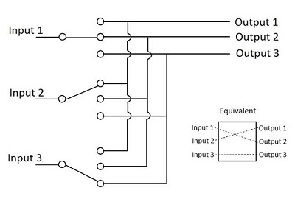
Circuit Switching
Space Division Switching Time Division Switching
Signal paths are physically separated Use digital time division techniques from one another to set up and maintain virtual
circuits
Originally designed for analog networks, It comes under Digital switching
but it is being used for both analog and technique.
digital switching
Circuit Switching Cont.

Slide 8
Advantages & Disadvantages
Advantages | Disadvantages
The bandwidth used is fixed. | Since dedicated channels are used, the bandwidth required is more.
The quality of communication is increased as a dedicated communication channel is used. | The utilization of resources is not full.
The rate at which the data is transmitted is fixed. | Since a dedicated channel has been used, the transmission of other data becomes impossible.
While switching, no time is wasted in waiting. | Circuit switching is expensive because every connection uses a dedicated path establishment.
It is preferred when the communication is long and continuous. | Great for only voice communication

Slide 9
Packet Switching ?

Slide 10
Packet Switching
packet switching does not require the use of a dedicated channel.
Packet-based networks break down a message into smaller data packets which then look for the most efficient route available.
Packet switching is defined as the connectionless
Packet contain user data and control information
User data may be part of a larger message
Control information includes routing (Addressing)

Slide 11
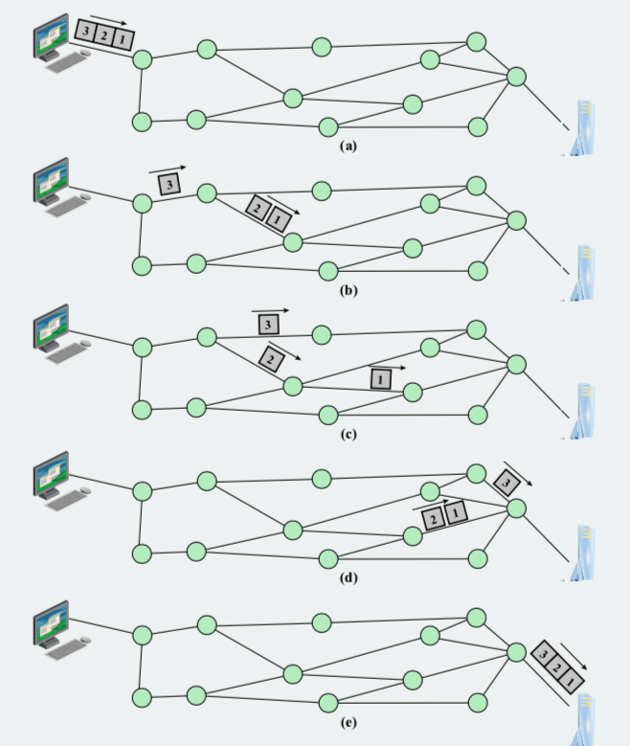
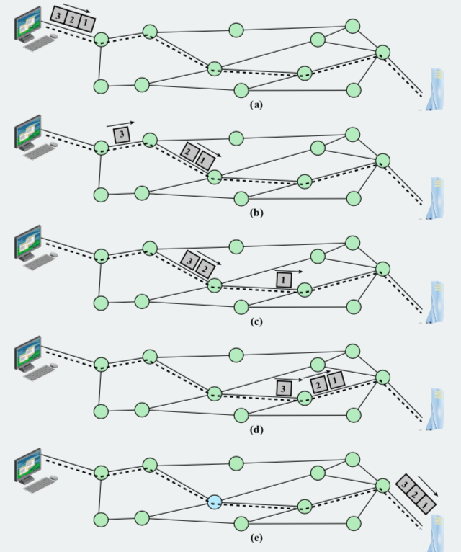
Packet Switching Cont.
Packet Switching
Datagram
Virtual Circuit
Each packet is treated independently with no reference to the previous packet
A preplanned route is established before any packets are sent.

Slide 12
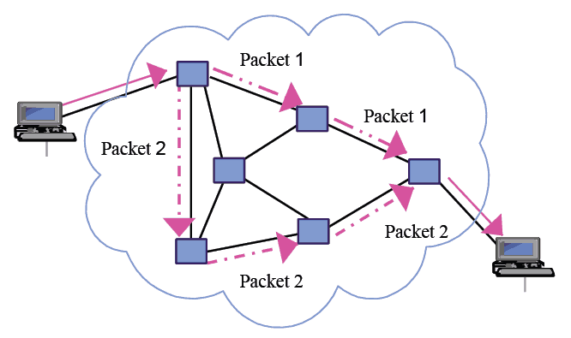
Packet Switching Cont.

Slide 13
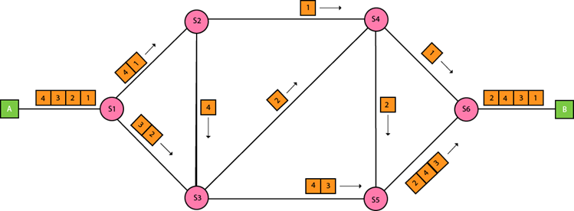
Packet Switching Cont.

Slide 14
Advantages & Disadvantages
Advantages | Disadvantages
More efficient than circuit switching | Not ideal for applications that are in constant use, such as high volume voice calls
Data packets are able to find the destination without the use of a dedicated channel | There is a lack of security protocols for data packets during transmission
Reduces lost data packets because packet switching allows for resending of packets | High-volume networks can lose data packets during high-traffic times; those data packets cannot be recovered or resent during transmission
More cost-effective since there is no need for a dedicated channel for voice or data traffic

Slide 15
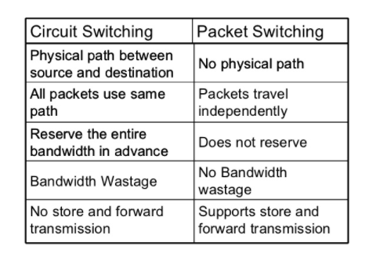
Circuit Switching vs Packet Switching

Slide 16

Thank You

